Slide 1

Can Emerging Innovative Technologies help to scale the EE interventions?
How?

Slide 2
Global commercial real estate (CRE) Investment: US$ 341 Billion Growing
at the rate of 13% YoY *
40-45 Million Sq. Ft. per year by 2020^
Shared Economics
Co working space
* JLL Global Market Perspective 2019 ^report by Cushman and Wakefield

Slide 3

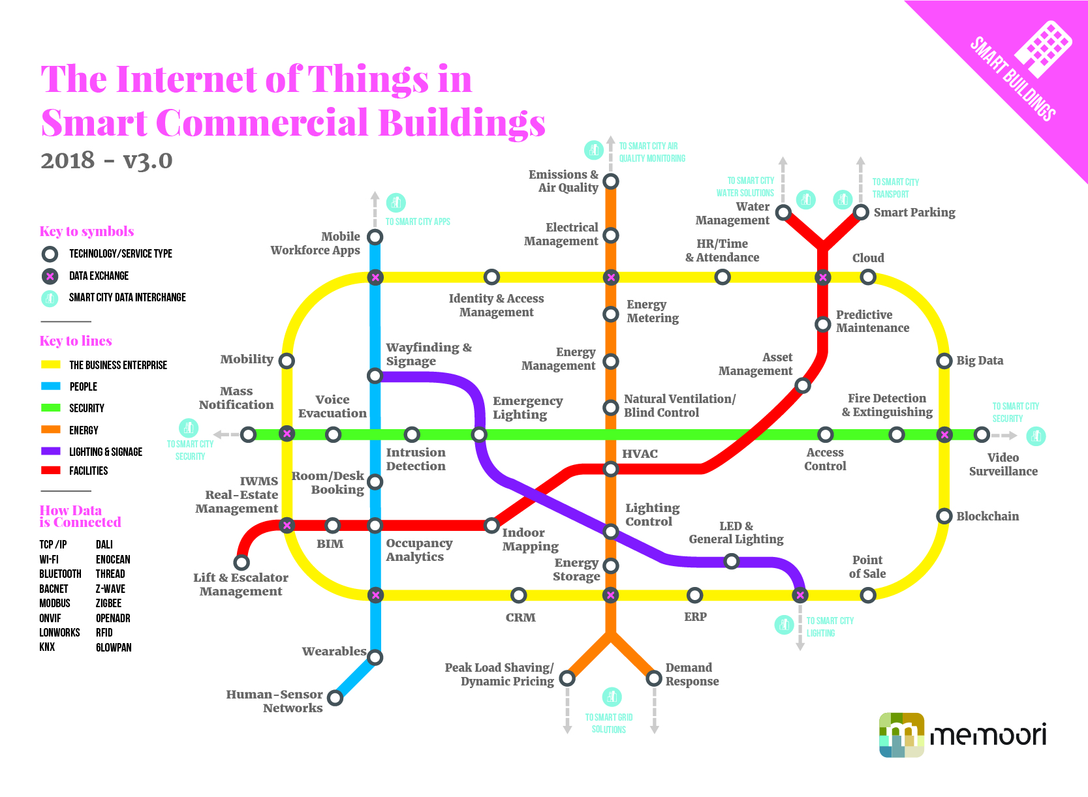

Slide 4



Enablers
Resiliency
Sustainability
Flexibility

Slide 5



Problems
Legacy Systems, Inflexible Solutions
Complex Data
*Commercial Real Estate Sector

Slide 6

What can be done?
Open the data Vault
Recognize Human element
Changing business models

Slide 7
Thank You!
Sumit.nawathe@entechventures.com

